Slide 1
CS F222: Discrete Structures
for
Computer Science
Topic: Relations
Dr. Raghunath Reddy

Slide 2
Relations
Any set $R⊆A×B$ is a relation from the set A to the set B.
Example: R = {(a, 0), (a, 1), (a, 3), (b, 1), (b, 2), (c, 0), (c, 3)} is a relation from the set {a, b, c} to the set {0, 1, 2, 3},
$a R b$denotes $\left(a, b\right)∈R$.
A relation from a set A to itself is called a relation on A.
The number of relations on a set A with n elements is $2^{n^{2}}$

Slide 3

Examples:
Let A = {1, 2, 3, 4} be a set. List the order pairs in the relation, defined on A,
R = {(a, b) | a divides b}.

Slide 4
Complementary Relations and Inverse relations
Let R be any binary relation from A to B. Then, , the complement of R, is the binary relation defined by $R^{c}=\left\{\left(a, b\right)\right|\left(a, b\right)∉R\}=(A×B) −R$
Any binary relation R:A×B has an inverse relation R⁻¹:B×A, defined by R⁻¹ :≡ {(b,a) | (a,b)∈R}.

Slide 5
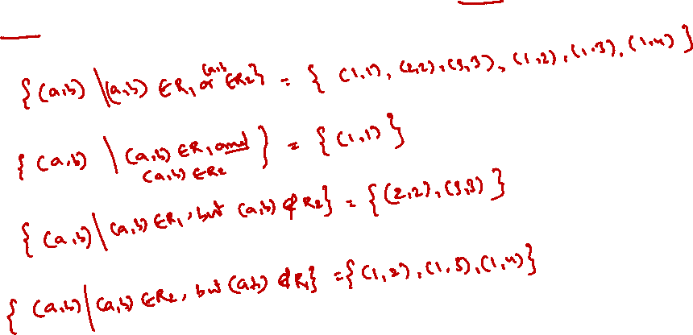
Combining Relations
Let A = {1, 2, 3} and B = {1, 2, 3, 4}. The relations R1 = {(1, 1), (2, 2), (3, 3)} and
R2 = {(1, 1), (1, 2), (1, 3), (1, 4)} can be combined to obtain
R1 ∪ R2 =
R1 ∩ R2 =
R1 − R2 =
R2 − R1 =

Slide 6
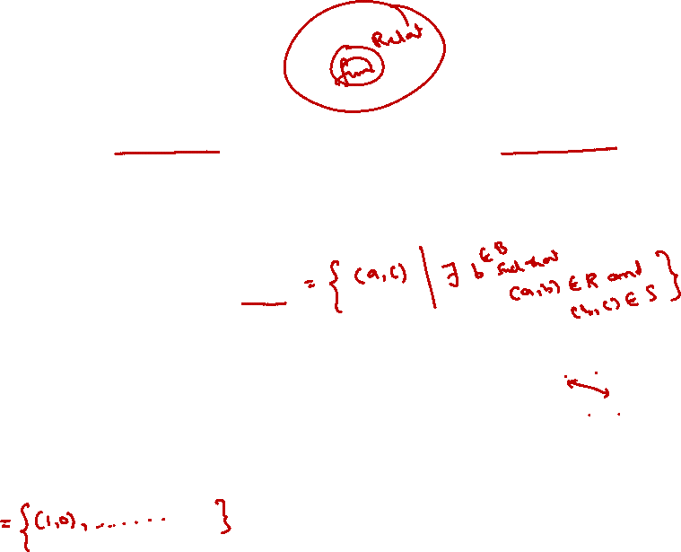
Composition of Relations
Let R be a relation from a set A to a set B and S a relation from B to a set C.
The composite of R and S is the relation consisting of ordered pairs (a, c), where a ∈ A, c ∈ C, and for which there exists an element b ∈ B such that (a, b) ∈ R and (b, c) ∈ S.
We denote the composite of R and S by S ◦ R.
Example: Let R be the relation from {1, 2, 3} to {1, 2, 3, 4} with R = {(1, 1), (1, 4), (2, 3), (3, 1), (3, 4)} and S is the relation from {1, 2, 3, 4} to {0, 1, 2} with S = {(1, 0), (2, 0), (3, 1), (3, 2), (4, 1)}.
What is the composite of the relations R and S?

Slide 7
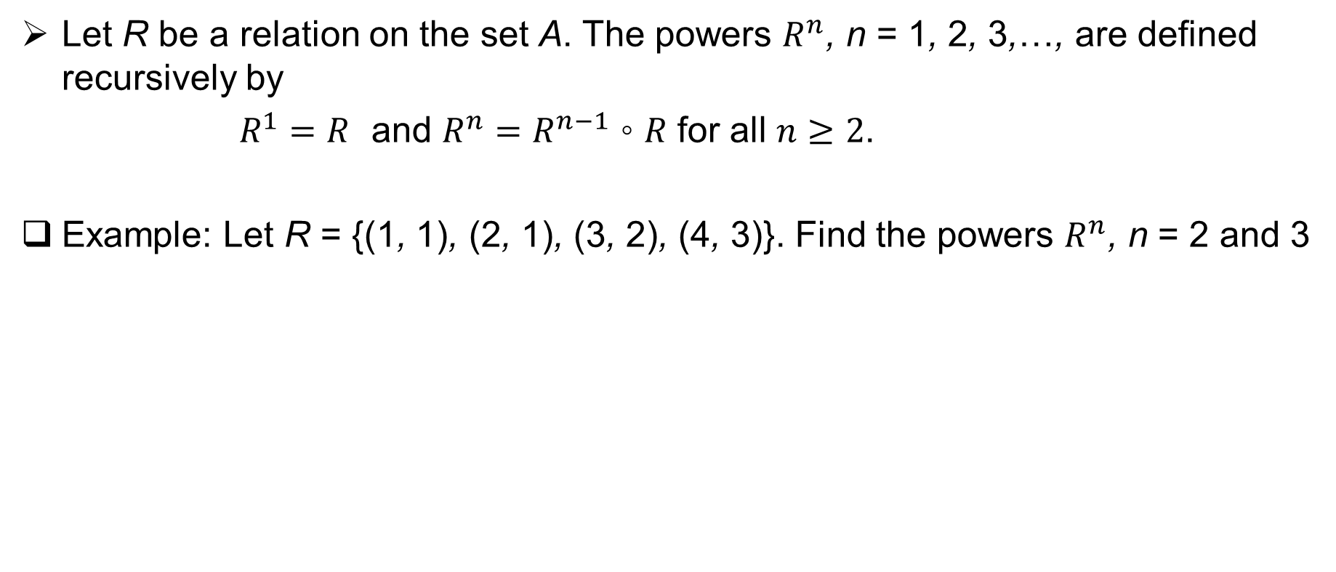
Powers of a relation
Let R be a relation on the set A. The powers $R^{n}$, n = 1, 2, 3,…, are defined recursively by
$R^{1}=R$ and $R^{n}=R^{n−1} \text{◦} R$ for all $n≥2$.
Example: Let R = {(1, 1), (2, 1), (3, 2), (4, 3)}. Find the powers $R^{n}$, n = 2 and 3

Slide 8
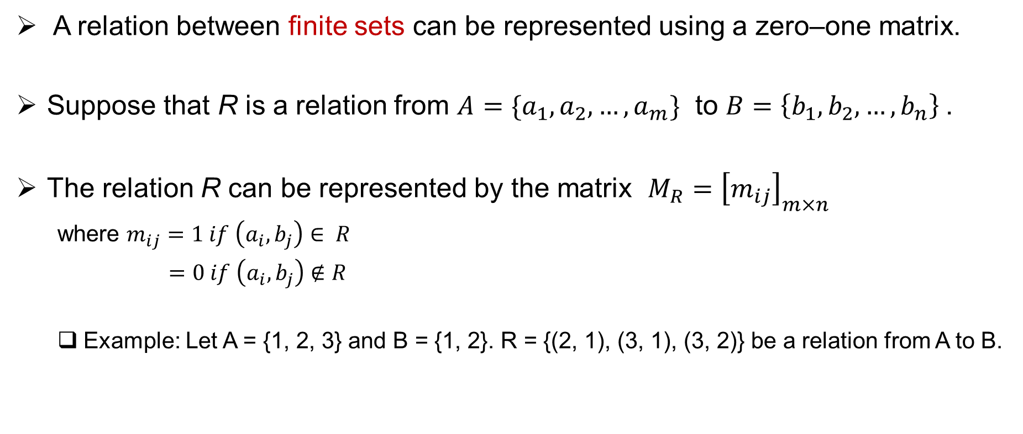
Representing relations using Matrices
A relation between finite sets can be represented using a zero–one matrix.
Suppose that R is a relation from $A=\{a_{1},a_{2},…, a_{m}\}$ to $B=\left\{b_{1},b_{2},…, b_{n}\right\}$.
The relation R can be represented by the matrix $M_{R}={\left[m_{ij}\right]}_{m×n}$
where $m_{ij}=1 if \left(a_{i}, b_{j}\right)∈ R$
$=0 if \left(a_{i}, b_{j}\right)∉R$
Example: Let A = {1, 2, 3} and B = {1, 2}. R = {(2, 1), (3, 1), (3, 2)} be a relation from A to B.

Slide 10
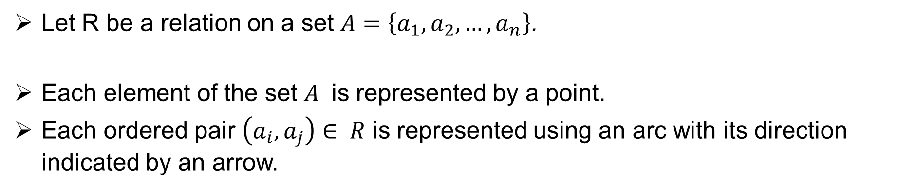
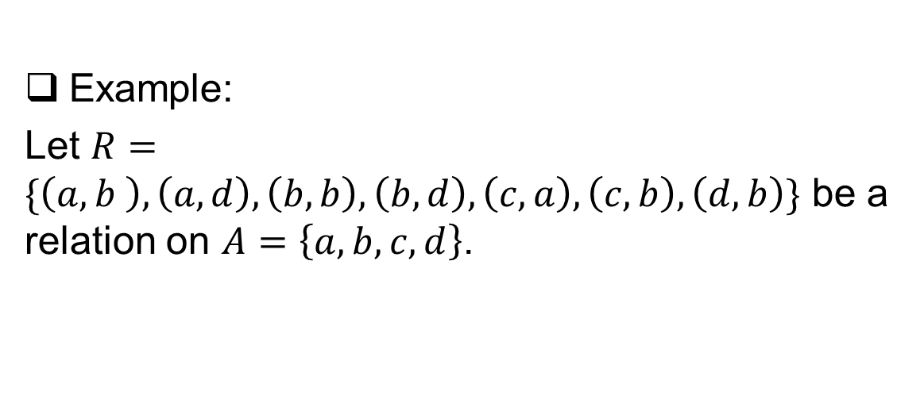
Representing relations using diagraph
Let R be a relation on a set $A=\left\{a_{1},a_{2},…, a_{n}\right\}$.
Each element of the set $A$ is represented by a point.
Each ordered pair $\left(a_{i}, a_{j}\right)∈ R$ is represented using an arc with its direction indicated by an arrow.
Example:
Let $R=\{\left(a,b \right), \left(a, d\right), \left(b, b\right), \left(b, d\right), \left(c, a\right), \left(c, b\right), \left(d, b\right)\}$ be a relation on $A=\left\{a, b, c, d\right\}$.

Slide 11
Properties of relations

Slide 12
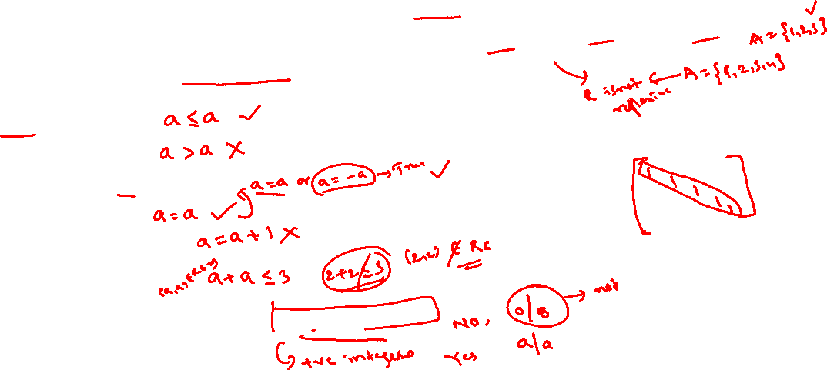
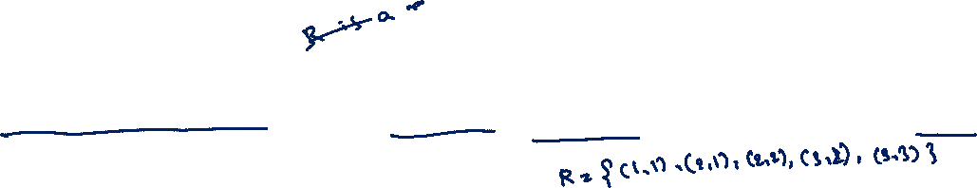
Reflexive
A relation R on a set A is called reflexive if (a, a) ∈ R for every element a ∈ A.
R = {(a, b) | a divides b } on a set of integers.

Slide 13
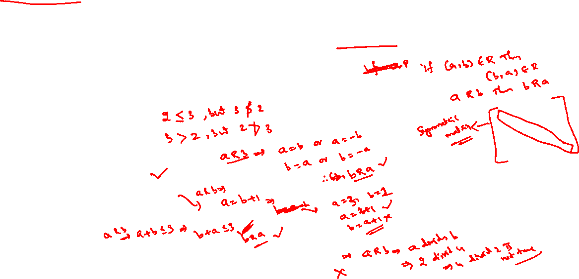
Symmetric
A relation R on a set A is called symmetric if (b, a) ∈ R whenever (a, b) ∈ R, for all a, b ∈ A.
R = {(a, b) | a divides b } on a set of integers.

Slide 14
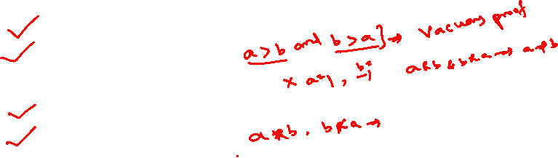
Antisymmetric
A relation R on a set A such that for all a, b ∈ A, if (a, b) ∈ R and (b, a) ∈ R, then a = b is called antisymmetric.
R = {(a, b) | a divides b } on a set of integers.

Slide 15
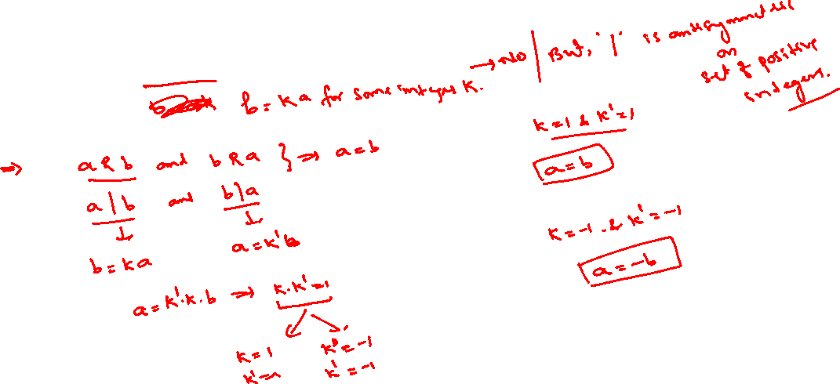

R = {(a, b) | a divides b } on a set of integers

Slide 16
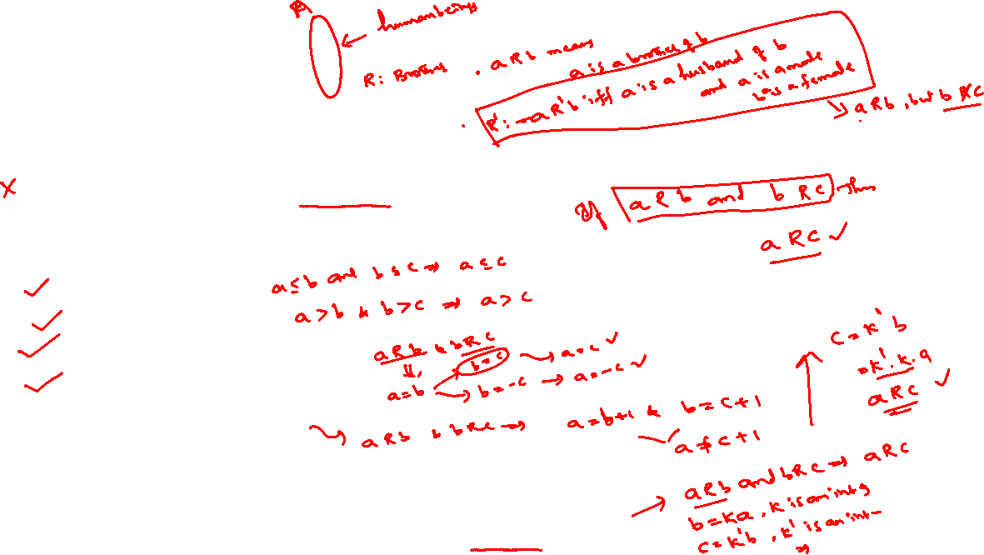
Transitive
A relation R on a set A is called transitive if whenever (a, b) ∈ R and (b, c) ∈ R,
then (a, c) ∈ R, for all a, b, c ∈ A.
R = {(a, b) | a divides b } on a set of positive integers.

Slide 17
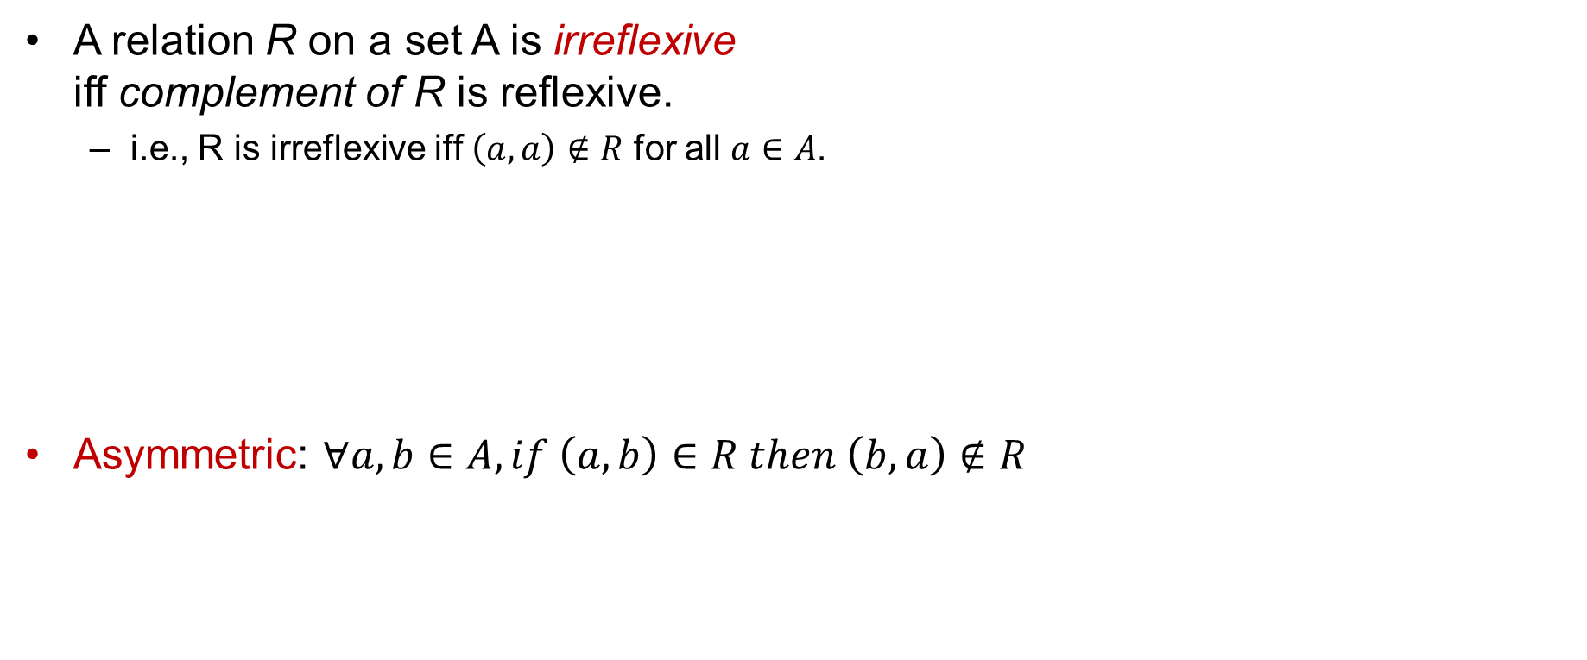
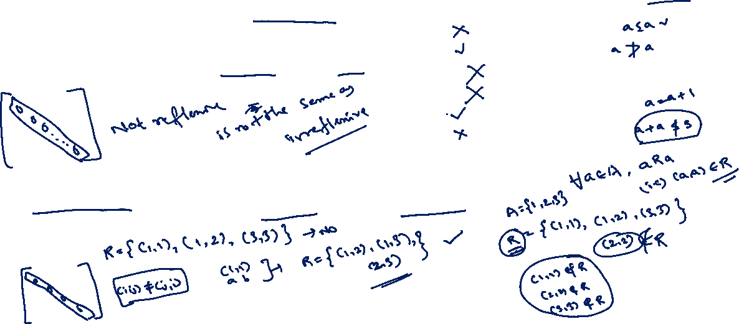
Some other properties
A relation R on a set A is irreflexive iff complement of R is reflexive.
i.e., R is irreflexive iff $\left(a, a\right)∉R$ for all $a∈A$.
Asymmetric: $∀a, b∈A, if \left(a, b\right)∈R then \left(b, a\right)∉R$

Slide 18
Equivalence and Partial order relations

Slide 19
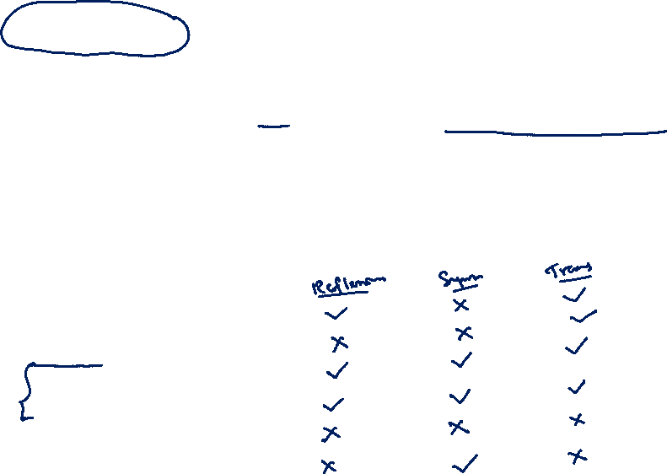
Equivalence relations
A relation on a set A is called an equivalence relation if it is
Reflexive,
Symmetric, and
Transitive.

Slide 20
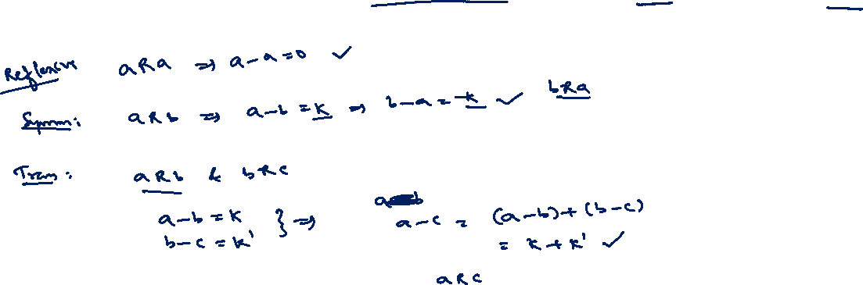
Equivalence relations (Example 1)
Let R be the relation on the set of real numbers such that aRb if and only if a − b is an integer

Slide 21
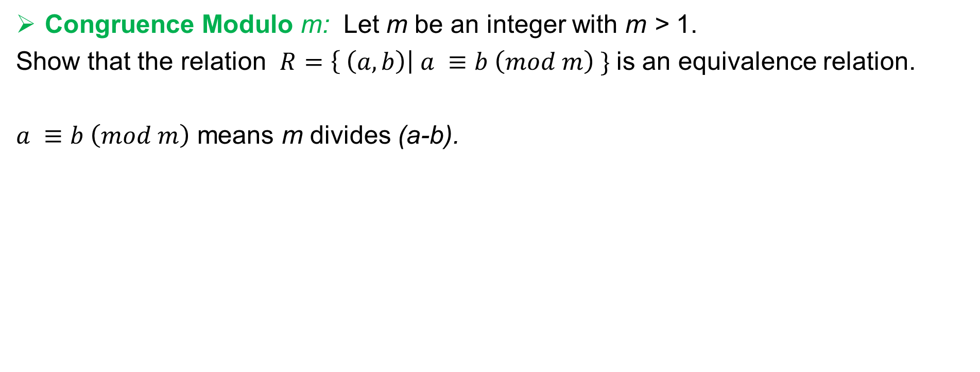
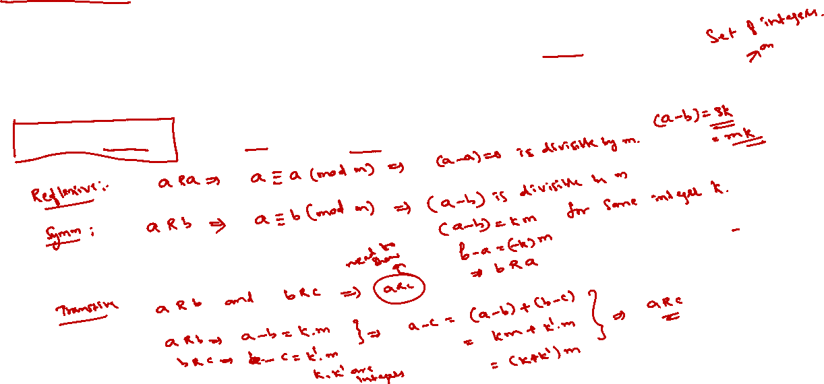
Equivalence relations (Example 2)
Congruence Modulo m: Let m be an integer with m > 1.
Show that the relation $R=\left\{ \left(a, b\right)\right| a ≡b \left(mod m\right) \}$ is an equivalence relation.
$a ≡b \left(mod m\right)$ means m divides (a-b).

Slide 22
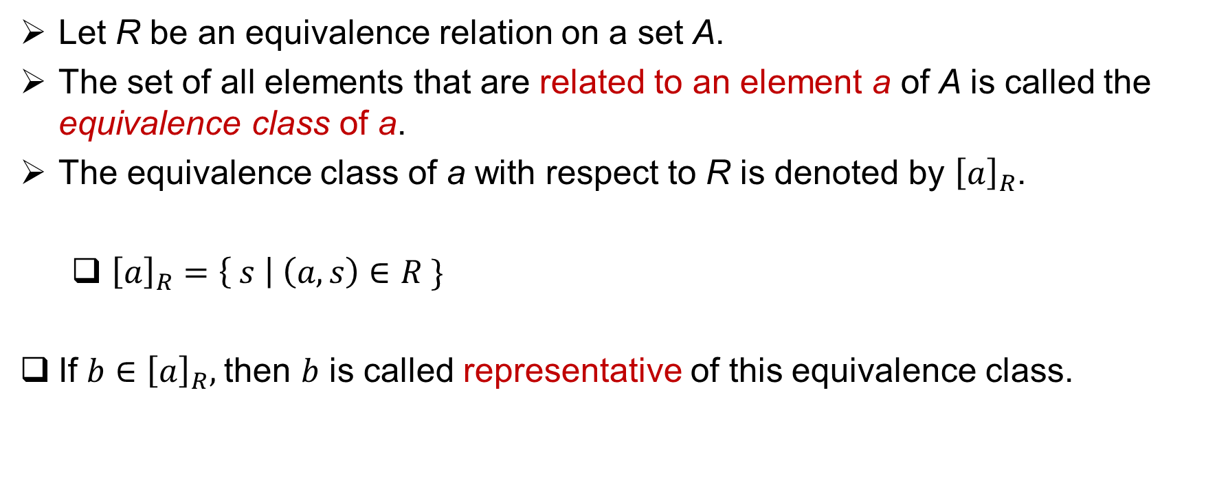
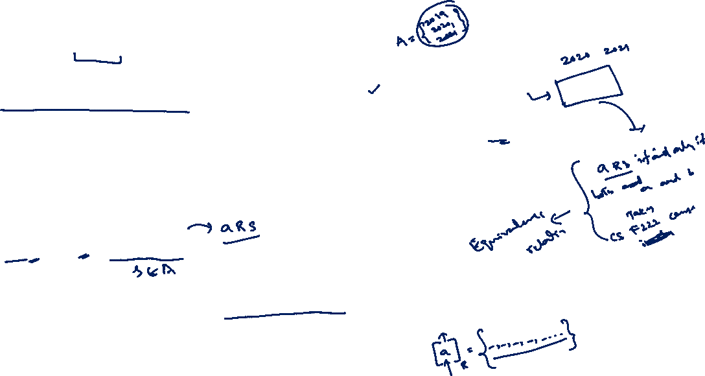
Equivalence class
Let R be an equivalence relation on a set A.
The set of all elements that are related to an element a of A is called the equivalence class of a.
The equivalence class of a with respect to R is denoted by ${\left[a\right]}_{R}$.
${\left[a\right]}_{R}=\left\{ s \right| \left(a, s\right)∈R \}$
If $b∈{\left[a\right]}_{R},$then $b$ is called representative of this equivalence class.

Slide 23
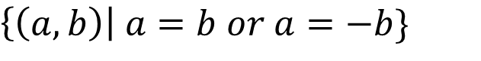
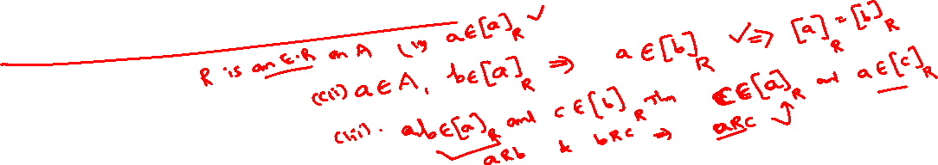
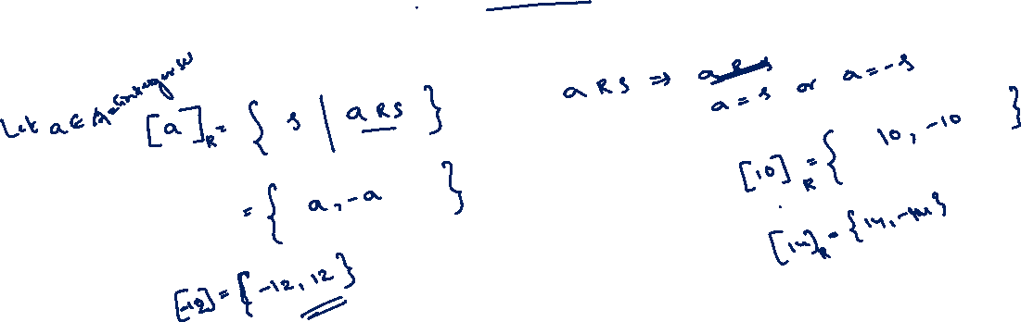
Equivalence class (Example 1)
What is the equivalence class of an integer under the following relation
$\left\{\left(a, b\right)\right| a=b or a=−b\}$

Slide 24
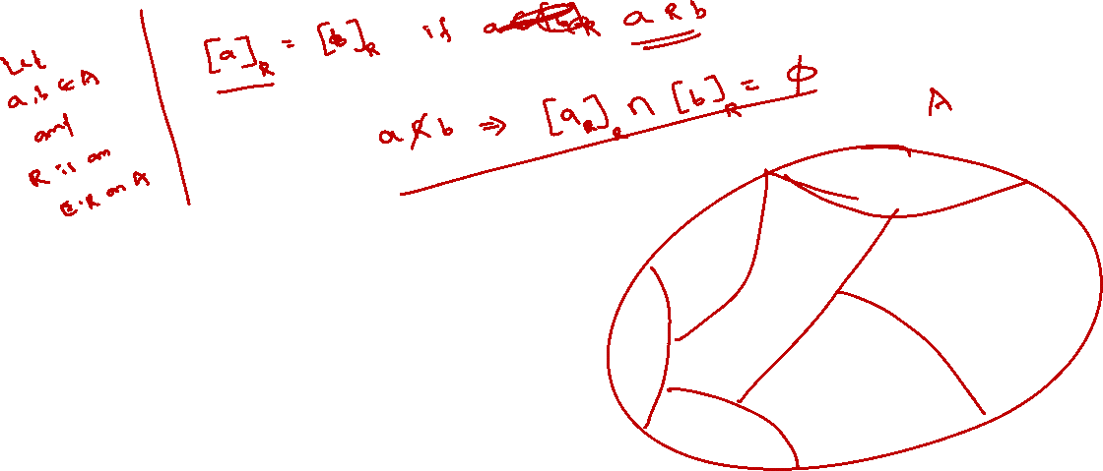

Slide 25
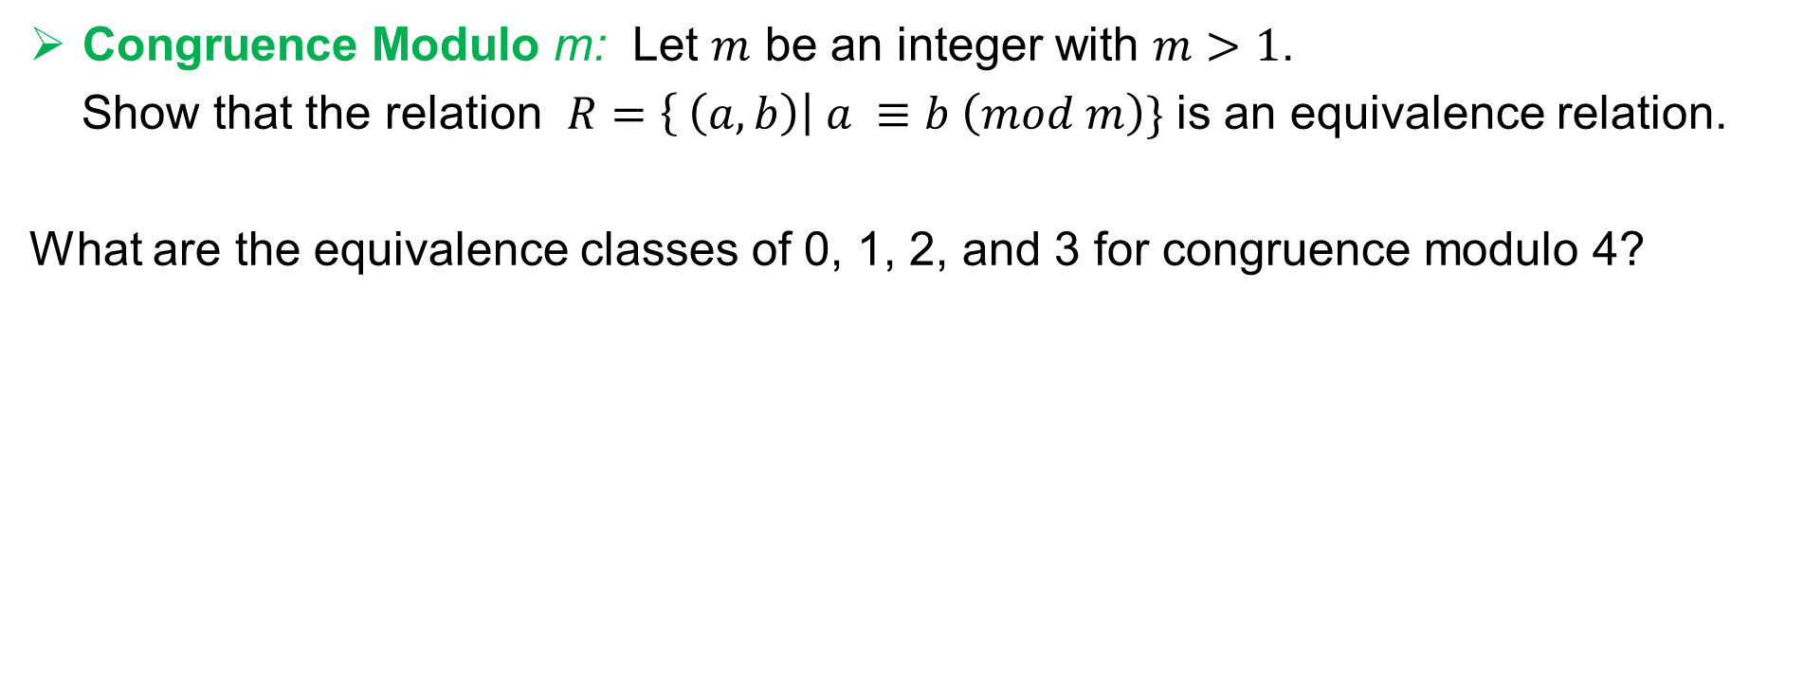
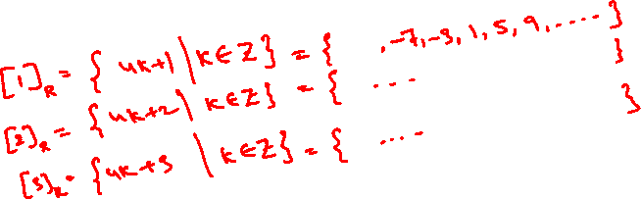
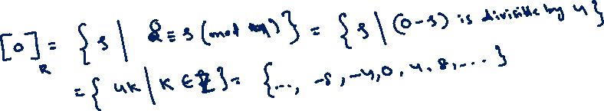
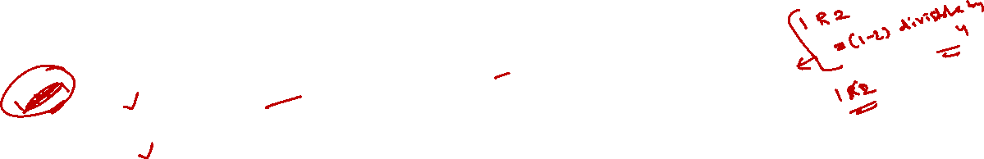
Equivalence class (Example 2)
Congruence Modulo m: Let $m$ be an integer with $m>1$.
Show that the relation $R=\left\{ \left(a, b\right)\right| a ≡b \left(mod m\right)\}$ is an equivalence relation.
What are the equivalence classes of 0, 1, 2, and 3 for congruence modulo 4?

Slide 26
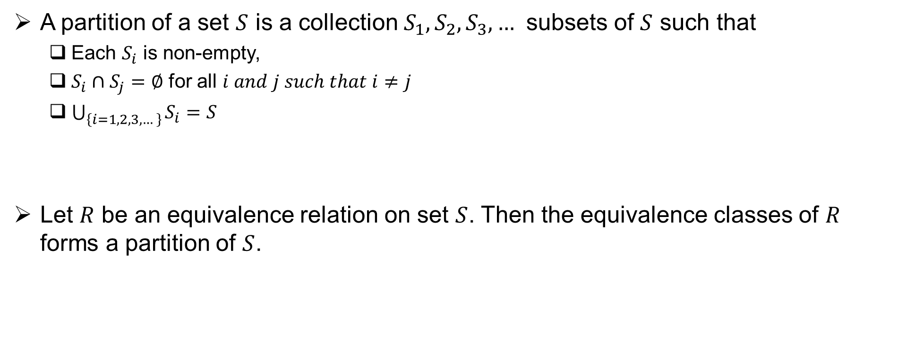
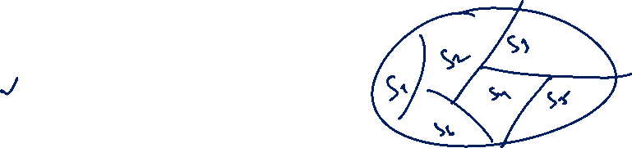
Equivalence class and Partitions
A partition of a set $S$ is a collection $S_{1},S_{2}, S_{3},…$ subsets of $S$ such that
Each $S_{i}$ is non-empty,
$S_{i}∩S_{j}=∅$ for all $i and j such that i≠j$
$\bigcup_{\left\{i=1, 2, 3, …\right\}}{S_{i}=S}$
Let $R$ be an equivalence relation on set $S$. Then the equivalence classes of $R$ forms a partition of $S$.

Slide 27
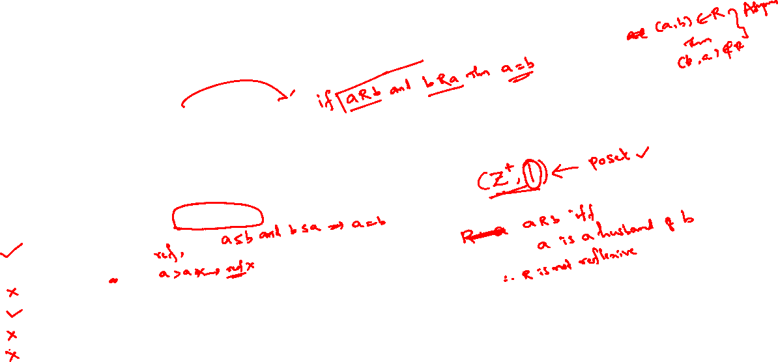
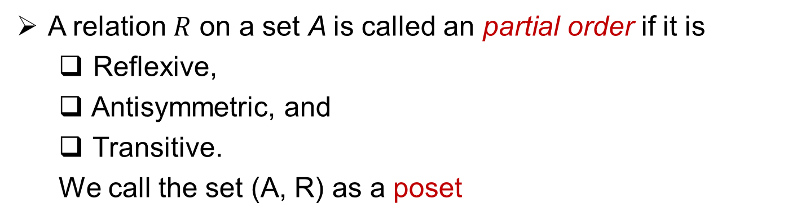
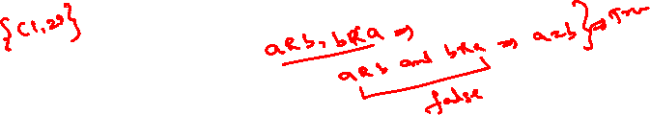
Partial order relations
A relation $R$ on a set A is called an partial order if it is
Reflexive,
Antisymmetric, and
Transitive.
We call the set (A, R) as a poset

Slide 28
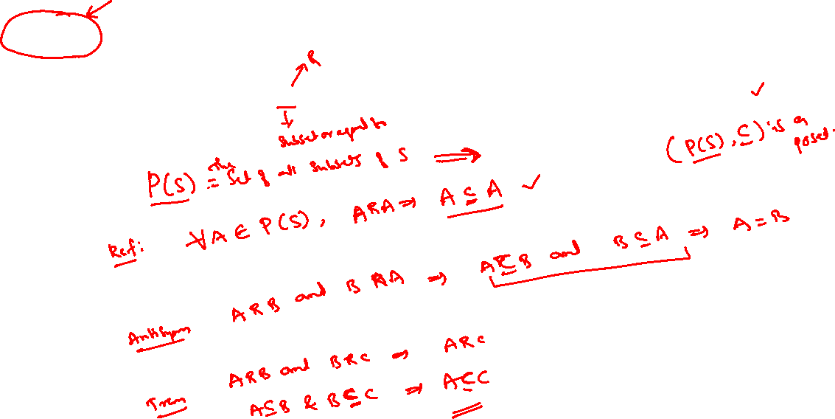
Partial order relations
Example: The relation ⊆ is a partial ordering on the power set of a set S.

Slide 29
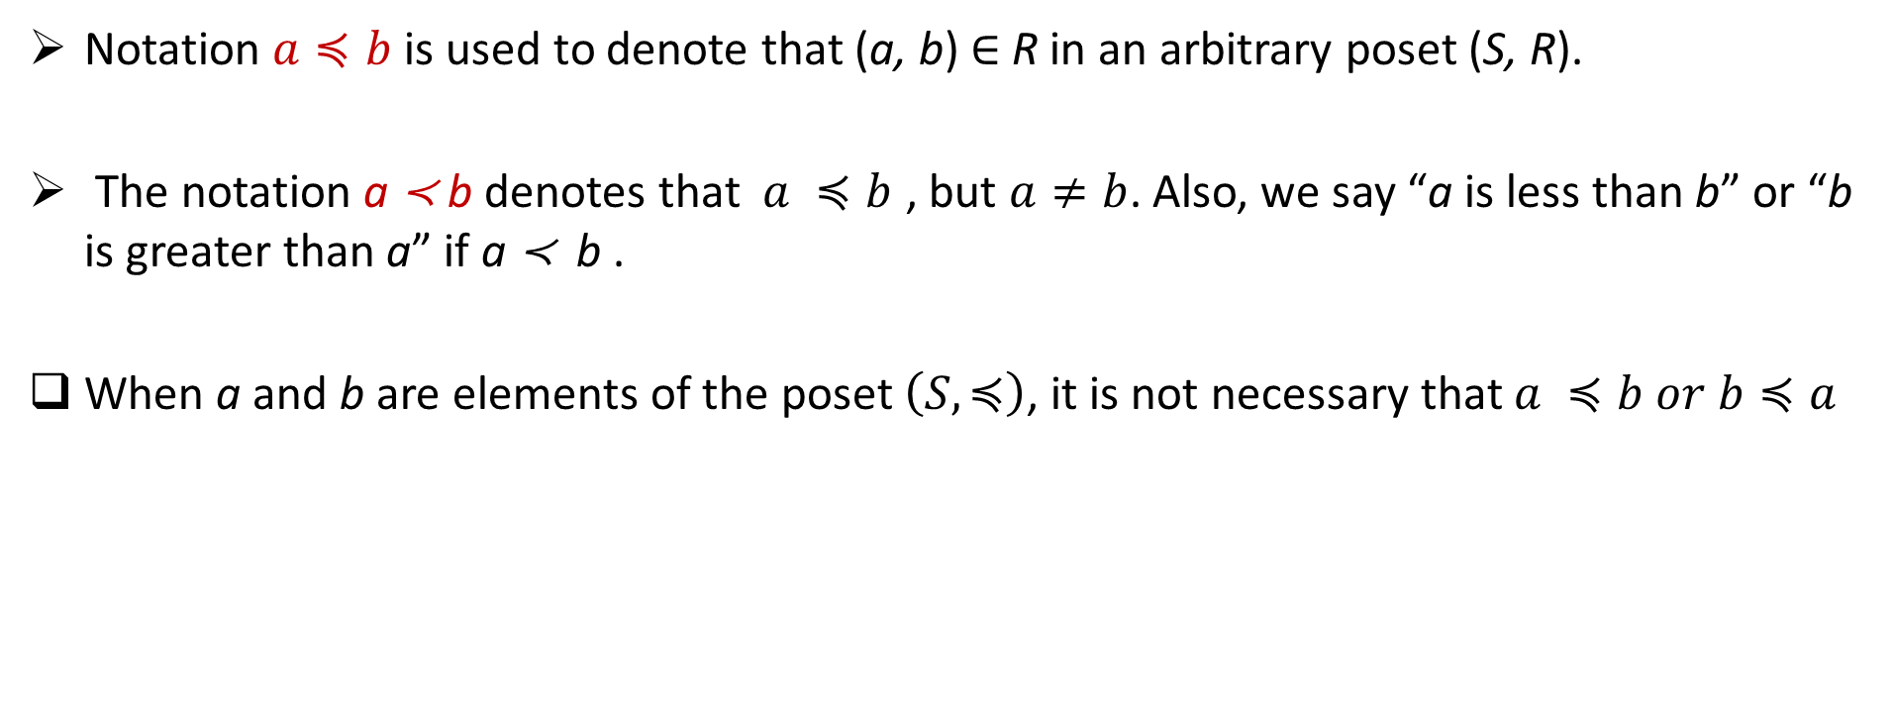
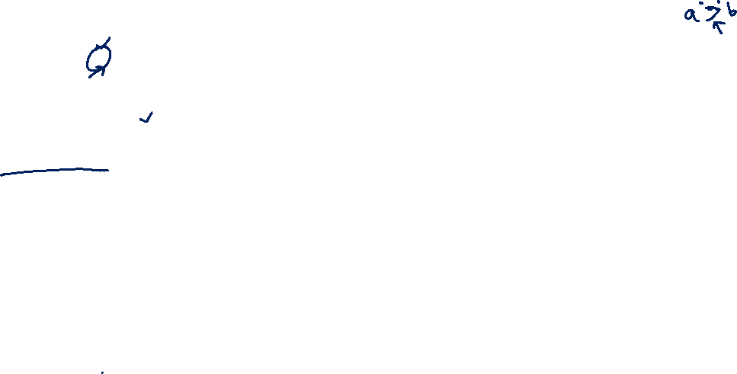
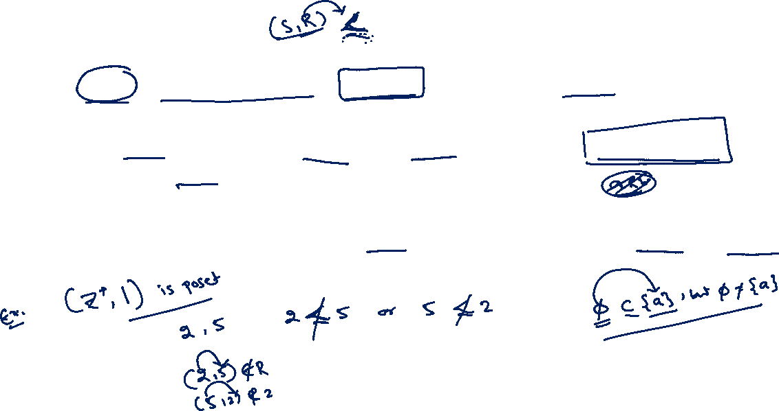
Notation for Posets
Notation $a≼b$ is used to denote that (a, b) ∈ R in an arbitrary poset (S, R).
The notation a ≺ b denotes that $a ≼b$ , but $a≠b$. Also, we say “a is less than b” or “b is greater than a” if a ≺ b .
When a and b are elements of the poset $\left(S, ≼\right)$, it is not necessary that $a ≼b or b≼a$

Slide 30
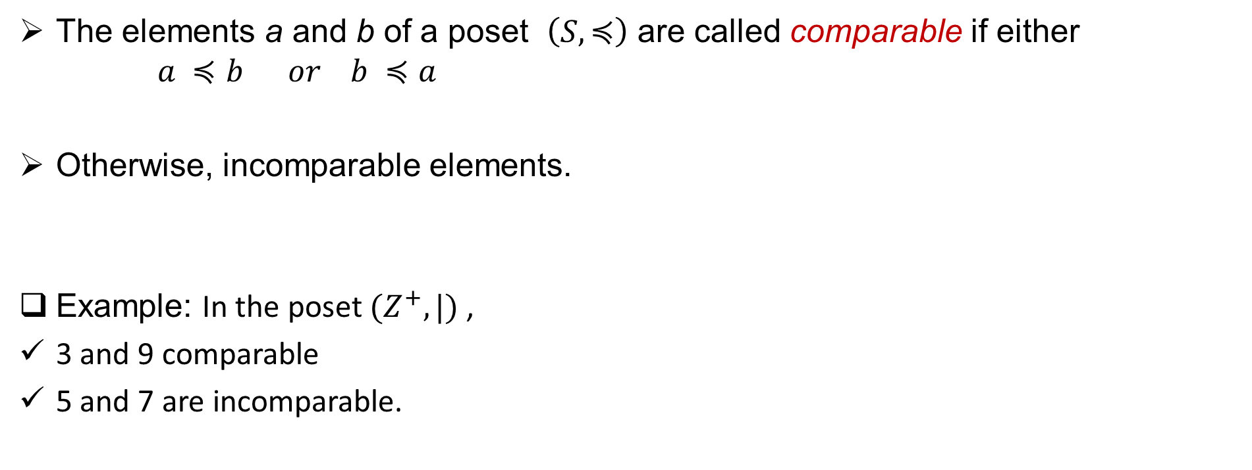
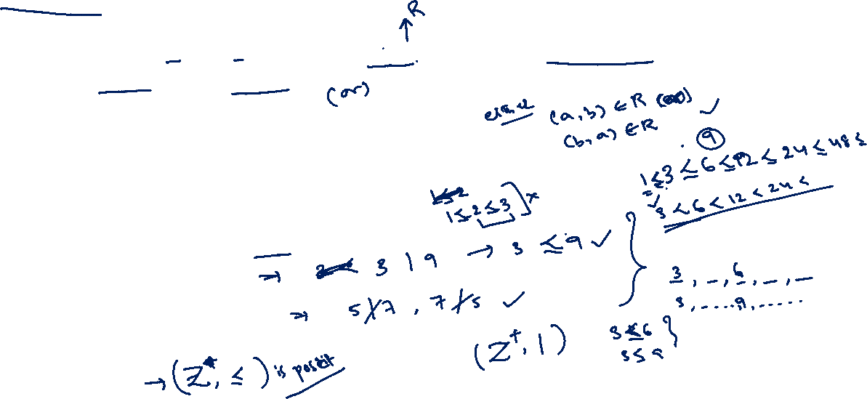
Comparable elements
The elements a and b of a poset $\left(S, ≼\right)$ are called comparable if either $a ≼b or b ≼a$
Otherwise, incomparable elements.
Example: In the poset $(Z^{+}, |)$ ,
3 and 9 comparable
5 and 7 are incomparable.

Slide 31
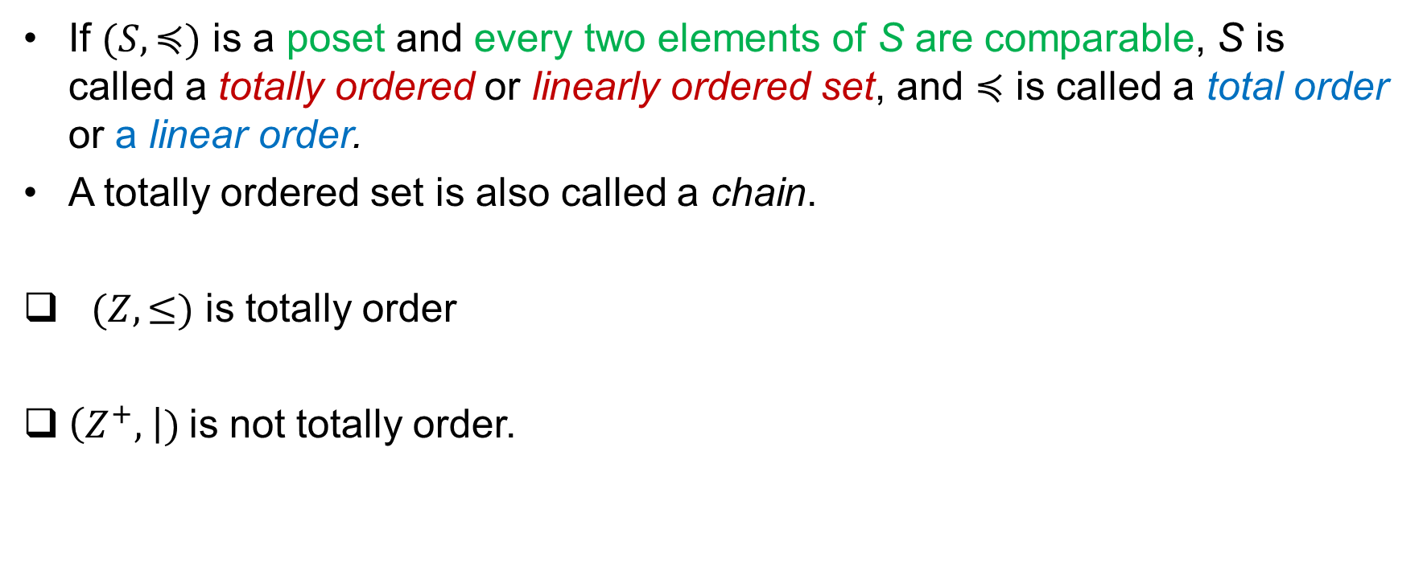
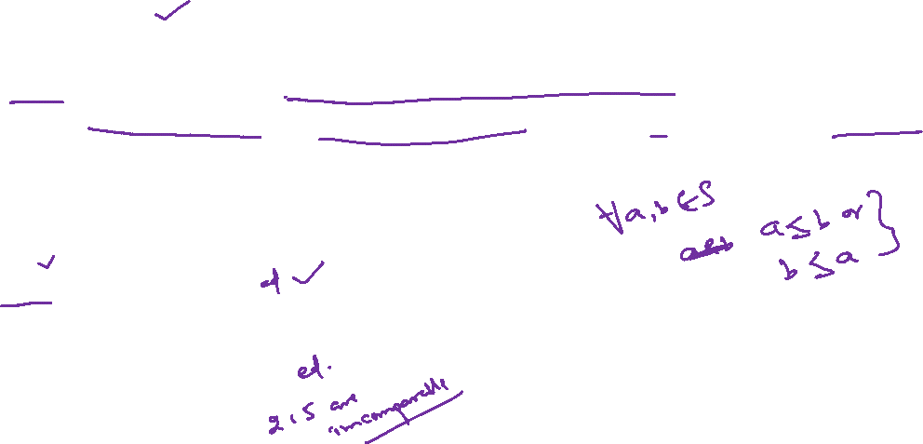
Total ordering
If $(S, ≼)$ is a poset and every two elements of S are comparable, S is called a totally ordered or linearly ordered set, and $≼$ is called a total order or a linear order.
A totally ordered set is also called a chain.
$(Z, ≤)$ is totally order
$\left(Z^{+}, \right|)$is not totally order.

Slide 32
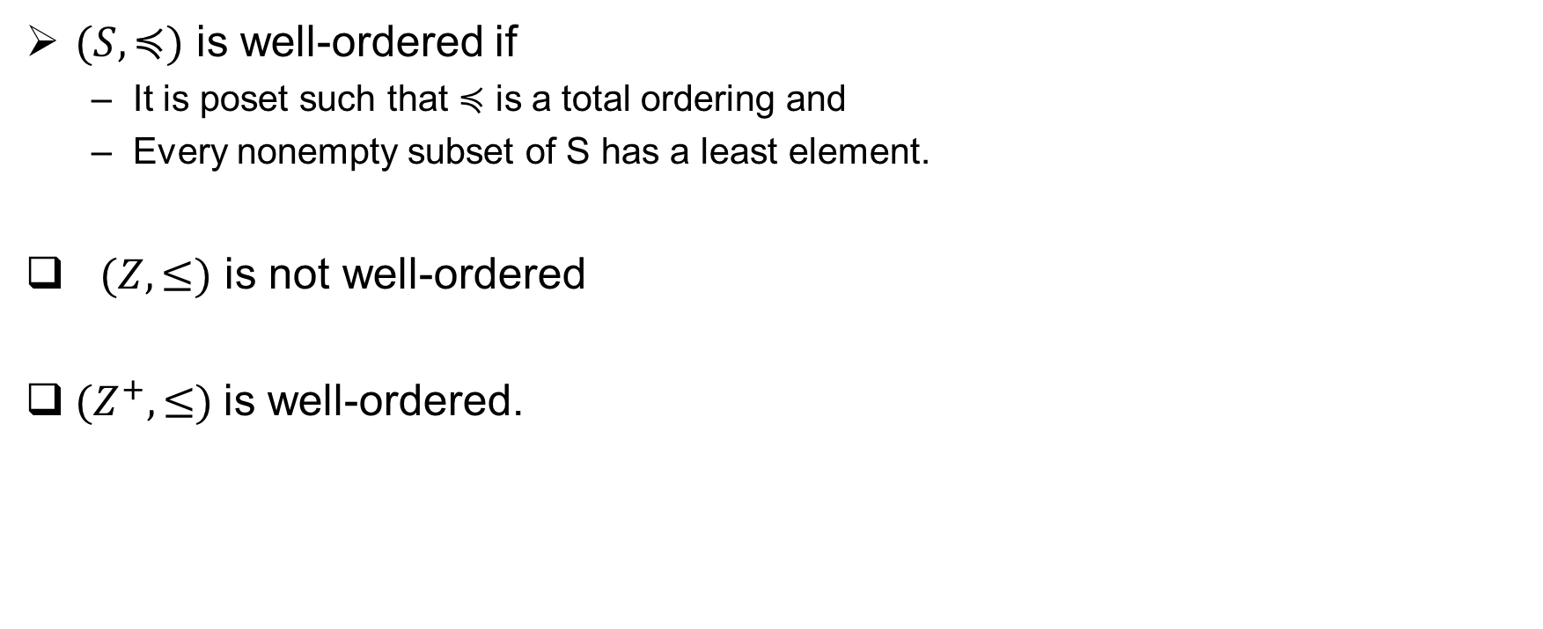
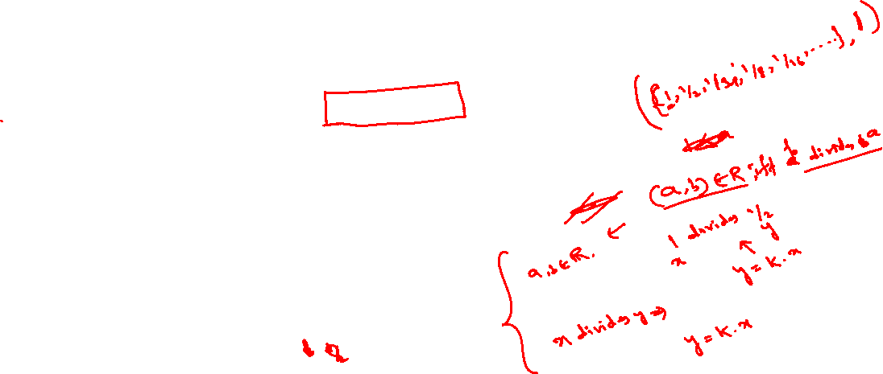
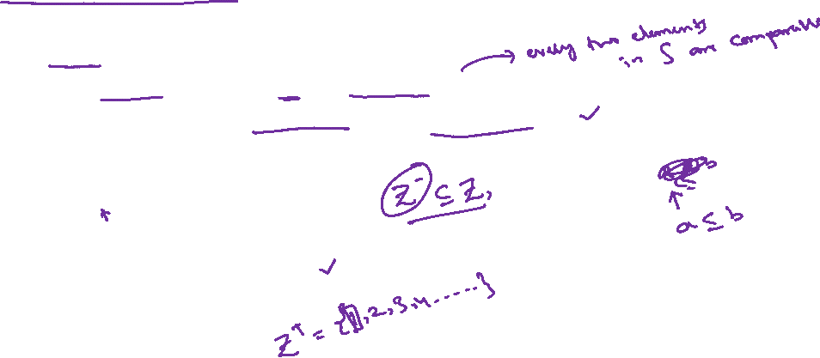
Well-ordered set
$(S, ≼)$ is well-ordered if
It is poset such that $≼$ is a total ordering and
Every nonempty subset of S has a least element.
$(Z, ≤)$ is not well-ordered
$(Z^{+}, ≤)$is well-ordered.

Slide 33
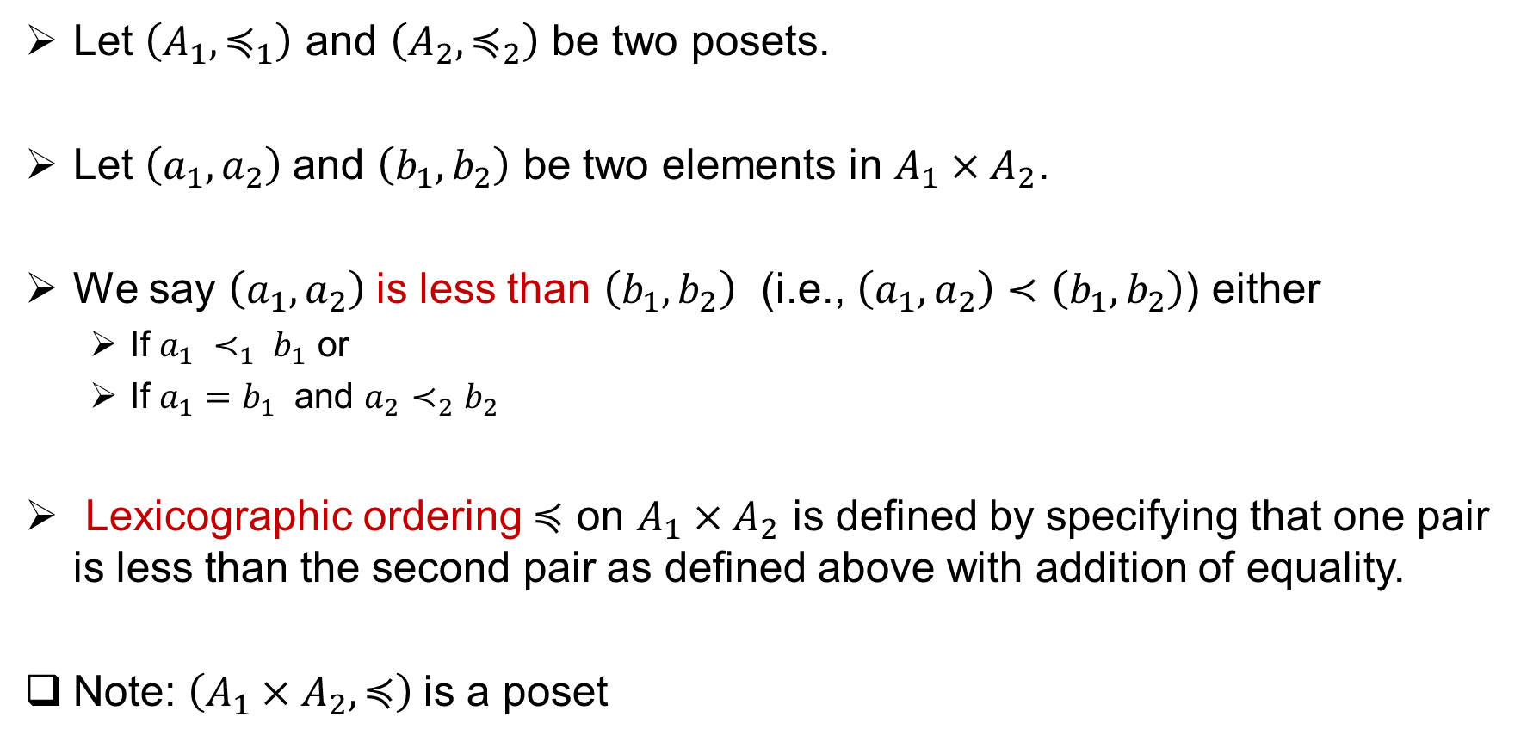
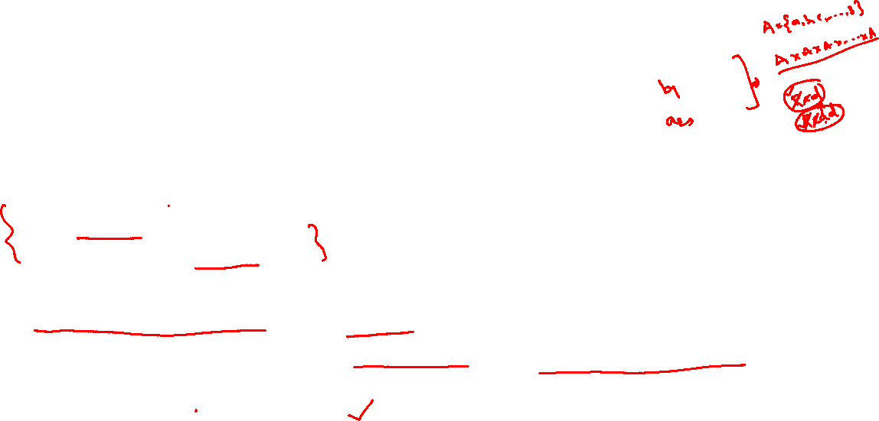
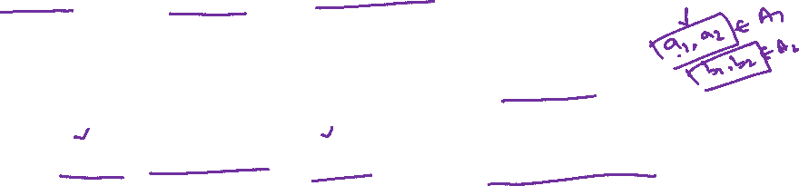
Lexicographic order
Let $\left(A_{1},≼_{1}\right)$ and $\left(A_{2}, ≼_{2}\right)$ be two posets.
Let $\left(a_{1},a_{2}\right)$and $\left(b_{1},b_{2}\right)$ be two elements in $A_{1}×A_{2}$.
We say $\left(a_{1},a_{2}\right)$is less than $\left(b_{1},b_{2}\right)$ (i.e., $\left(a_{1},a_{2}\right)≺\left(b_{1},b_{2}\right)$) either
If $a_{1} ≺_{1} b_{1}$ or
If $a_{1}=b_{1}$ and $a_{2}≺_{2}b_{2}$
Lexicographic ordering $≼$ on $A_{1}×A_{2}$ is defined by specifying that one pair is less than the second pair as defined above with addition of equality.
Note: $\left(A_{1}×A_{2}, ≼\right)$is a poset

Slide 34
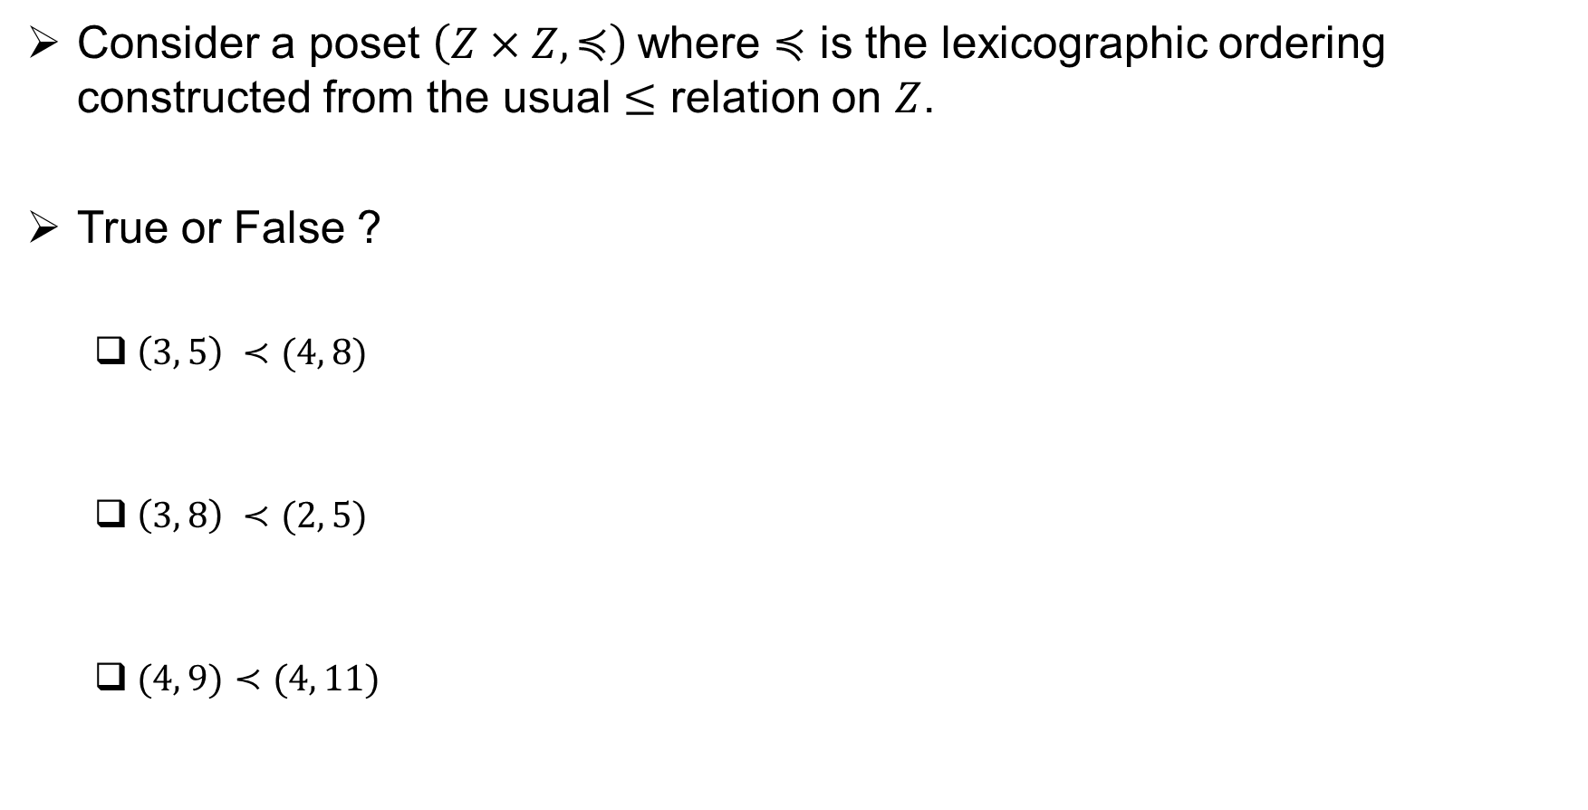
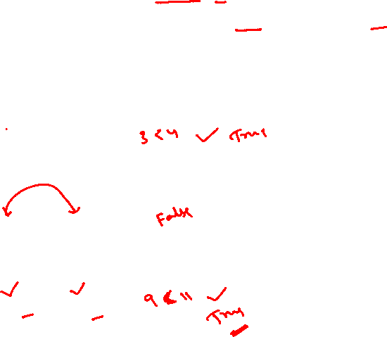
Lexicographic order (Example)
Consider a poset $\left(Z×Z, ≼\right)$where $≼$ is the lexicographic ordering constructed from the usual $≤$ relation on $Z$.
True or False ?
$\left(3, 5\right) ≺(4, 8)$
$\left(3, 8\right) ≺(2, 5)$
$(4, 9)≺(4, 11)$

Slide 35
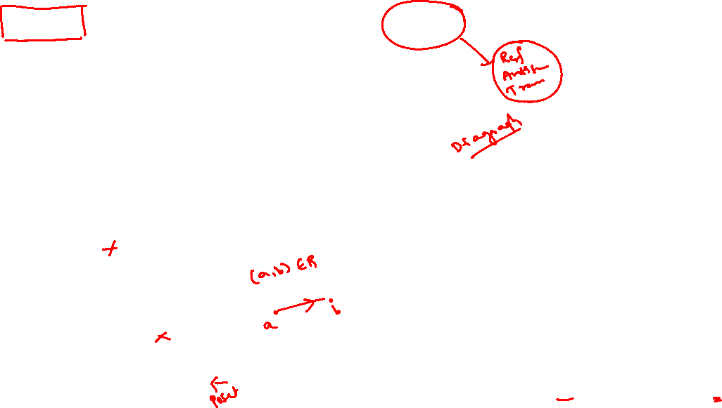


Hasse Diagrams to represent a Poset
$$(\left\{1, 2, 3, 4\right\}, ≤)$$
$$(\left\{1, 2, 3, 4, 6,8, 12\right\}, |)$$

Slide 36

Hasse Diagrams to represent a Poset (cont..)
$$(\left\{1, 2, 3, 4\right\}, ≤)$$

Slide 37


Hasse Diagrams to represent a Poset (cont..)
$$(\left\{1, 2, 3, 4, 6,8, 12\right\}, |)$$

Slide 38


Hasse Diagrams to represent a Poset (cont..)
Construct a Hasse diagram for $\left(P\left(\left\{1, 2, 3\right\}, ⊆\right)\right)$

Slide 39



Maximal and Minimal Elements
Let $\left(S, ≼\right)$ be a poset.
An element of $a∈S$ is called maximal if it is not less than any element of S
$a∈S$ is maximal if there is no $b∈S$ such that $a ≺b$
An element of $a∈S$ is called minimal if it is not greater than any element of S
$a∈S$ is minimal if there is no $b∈S$ such that $b≺a$

Slide 40



Maximal and Minimal Elements (example)
$$(\left\{2, 4, 5, 10, 12, 20, 25\right\}, |)$$
$$(\left\{1, 2, 3, 4, 6,8, 12\right\}, |)$$

Slide 41


Least and Greatest Elements
Let $\left(S, ≼\right)$ be a poset.
An element of $a∈S$ is called greatest element if it is greater than all the elements in S
$a∈S$ is greatest if $b ≼a$ for all $b∈S$
An element of $a∈S$ is called least element if it is less than all the elements in S
$a∈S$ is least element if $a≼b$ for all $b∈S$

Slide 42



Least and Greatest Elements (example)
$$(\left\{1, 2, 3, 4, 6,8, 12\right\}, |)$$

Slide 43


Upper and Lower bounds
Let $\left(S, ≼\right)$ be a poset and $A$be a subset of $S$.
If $u$ is an element of S such that $a ≼u$ for all elements $a∈A$, then $u$ is called an upper bound of A.
If $l$ is an element of S such that $l ≼a$ for all elements $a∈A$, then $l$ is called a lower bound of A.

Slide 44


Upper and Lower bounds (examples)
What are the upper and lower bounds of
{4, 10}
{2, 10, 20}
{4, 5, 25}
$$(\left\{2, 4, 5, 10, 12, 20, 25\right\}, |)$$

Slide 45
Upper and Lower bounds (examples)
What are the upper bound and lower bounds of
{a, b, c}
{j, h}

Slide 46

Least Upper Bound and Greatest Lower Bounds
The element x is called the least upper bound of the subset A if x is an upper bound that is less than every other upper bound of A.
The element y is called the greatest lower bound of A if y is a lower bound of A and greatest among all the lower bounds of A.

Slide 47

Least Upper Bound and Greatest Lower bounds (examples)
What are the least upper bound and greatest lower bounds of
{b, d, g}
{a, c, d, f}

Slide 48


Lattices
A partially ordered set in which every pair of elements has both a least upper bound and a greatest lower bound is called a lattice.
Ex: The poset $(Z^{+}, |)$ is lattice.
({1,2, 3, 4, 5}, |) is not a lattice.

Slide 49



Topological Sorting
Suppose that a project is made up of 20 different tasks. Some tasks can be completed only after others have been finished.
How can an order be found for these tasks?
To model this problem we set up a partial order on the set of tasks so that a ≺ b if and only if a and b are tasks where b cannot be started until a has been completed.
To produce a schedule for the project, we need to produce an order for all 20 tasks that is compatible with this partial order.

Slide 50


Topological Sorting (cont..)
A total ordering $≼$ is said to be compatible with the partial ordering R
if $a ≺b$whenever aRb.
Constructing a compatible total ordering from a partial ordering is called topological sorting
Lemma 1: Every finite nonempty poset $(S, ≼)$ has at least one minimal element.

Slide 51

Topological Sorting (cont..)
Algorithm:

Slide 52

Topological Sorting (cont..)
Ex: Find a compatible total ordering for the poset ({1, 2, 4, 5, 12, 20}, ∣).

Slide 53


Topological Sorting (cont..)
Ex: Find a compatible total ordering for the following poset

Slide 54
Closures of relations

Slide 55


Closure of a relation
If R is a relation on a set A, then the closure of R with respect to property P, if it exists, is the relation S on A with property P that contains R and is a subset of every subset of $A×A$containing R with property P.
Here, P is either reflexive, symmetric, or transitive property.

Slide 56


Reflexive Closure
What is the reflexive closure of $\left\{ \left(1,1\right), \left(1, 2\right), \left(2, 1\right), \left(3, 2\right)\right\}$ on the set $A=\{1, 2, 3\}$ ?
What is the reflexive closure of the relation $R=\left\{\left(a, b\right)\right|a<b\}$ on the set of integers?

Slide 57

Symmetric Closure
What is the reflexive closure of $\left\{ \left(1,1\right), \left(1, 2\right), \left(2, 1\right), \left(3, 2\right)\right\}$ on the set $A=\{1, 2, 3\}$ ?
What is the reflexive closure of the relation $R=\left\{\left(a, b\right)\right|a<b\}$ on the set of integers?

Slide 58


Transitive Closure
What is the reflexive closure of $\left\{ \left(1,3\right), \left(1, 4\right), \left(2, 1\right), \left(3, 2\right)\right\}$ on the set $A=\{1, 2, 3, 4\}$ ?

Slide 59


Transitive Closure

Slide 60
Thank You!!

